Slide 1
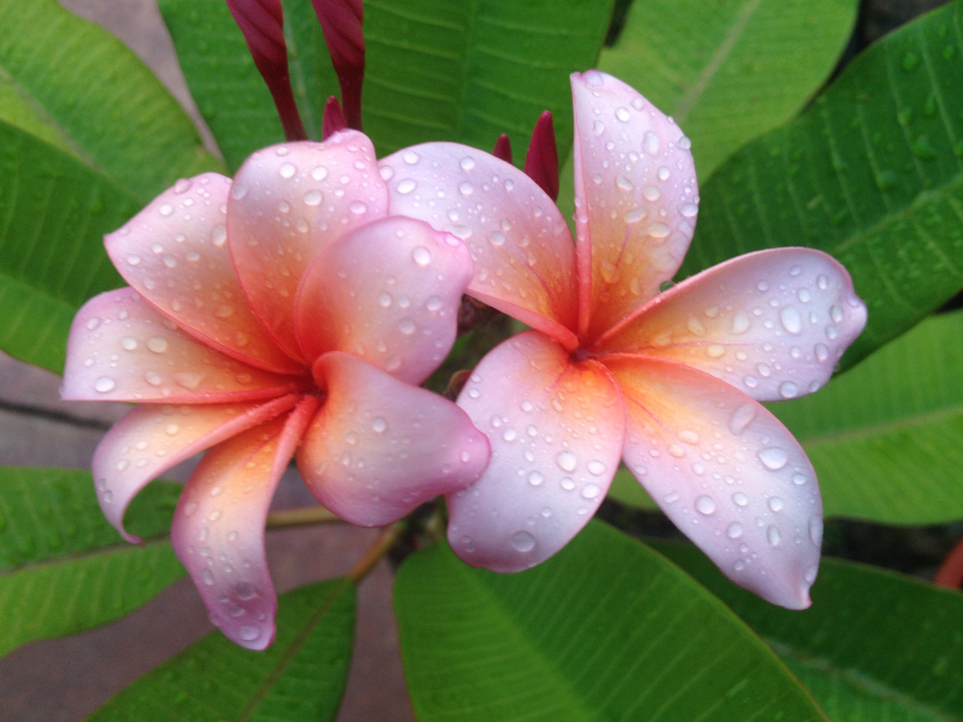
The Plumeria Society of America Plant Show & Sale
June 9, 2018 9:30 a.m. – 3:00 p.m.
Cash, checks and credit cards accepted
www.theplumeriasociety.org
Bay Area Community Center
5002 NASA Road 1, Seabrook, Texas 77586

